Slide 1
API
Application Programming interface

Slide 2
What api does
Responsible of interactivity between user side and server side
Example as waiter in a restraunt

Slide 3



API

Slide 4
Types of api
Open APIs: Also known as Public API, there are no restrictions to access these types of APIs because they are publicly available.
Partner APIs: A developer needs specific rights or licenses in order to access this type of API because they are not available to the public.

Slide 5
Types of apis
Internal APIs: Also known as Private APIs, only internal systems expose this type of API. These are usually designed for internal use within a company. The company uses this type of API among the different internal teams to be able to improve its products and services.
Composite APIs: This type of API combines different data and service APIs. It is a sequence of tasks that run synchronously as a result of the execution, and not at the request of a task. Its main uses are to speed up the process of execution and improve the performance of the listeners in the web interfaces.

Slide 6
Different types of api architechture / Web service APIs
SOAP
XML-RPC
JSON-RPC
REST
A web service is a system or software that uses an address, i.e., URL on the World Wide Web, to provide access to its services.

Slide 7
SOAP (Simple Object Access Protocol):
This is a protocol that uses XML as a format to transfer data. Its main function is to define the structure of the messages and methods of communication. It also uses WSDL, or Web Services Definition Language, in a machine-readable document to publish a definition of its interface.

Slide 8

XML-RPC:
This is a protocol that uses a specific XML format to transfer data compared to SOAP that uses a proprietary XML format. It is also older than SOAP. XML-RPC uses minimum bandwidth and is much simpler than SOAP. Example

Slide 9
JSON-RPC
This protocol is similar to XML-RPC but instead of using XML format to transfer data it uses JSON. Example

Slide 10
REST (Representational State Transfer)
REST is not a protocol like the other web services, instead, it is a set of architectural principles. The REST service needs to have certain characteristics, including simple interfaces, which are resources identified easily within the request and manipulation of resources using the interface.
Architectural style of web
Use of urls or requests

Slide 11
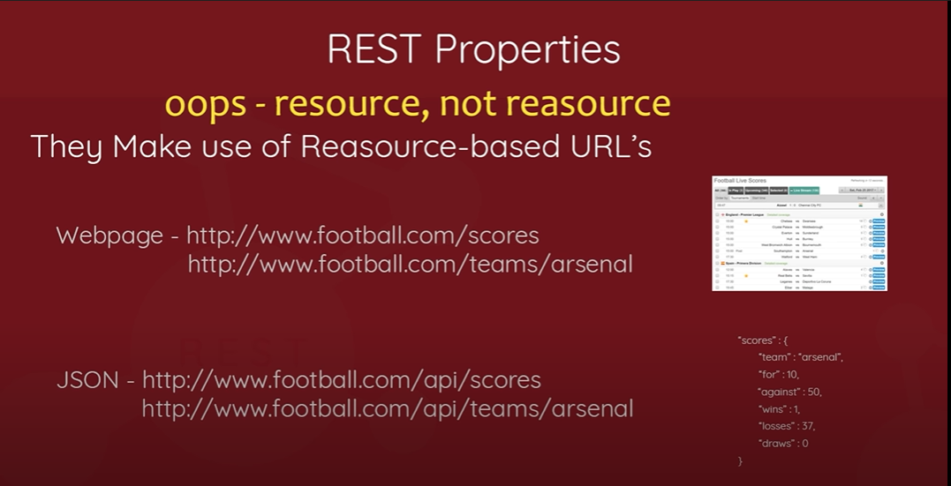
REST (Representational State Transfer)

